Slide 1
Galaxy Tools 2.0
Bring your own!
Marius van den Beek
PSU / SCI-SCALE
marius@galaxyproject.org

Slide 2
Why can’t users install tools ?
We don’t want to limit what you can do!
I need “xyz” and it’s not on the server I use, help please?
You can already run code with RStudio and Jupyter*
We can isolate storage and compute

Slide 3
Why can’t users install tools ?

Slide 4
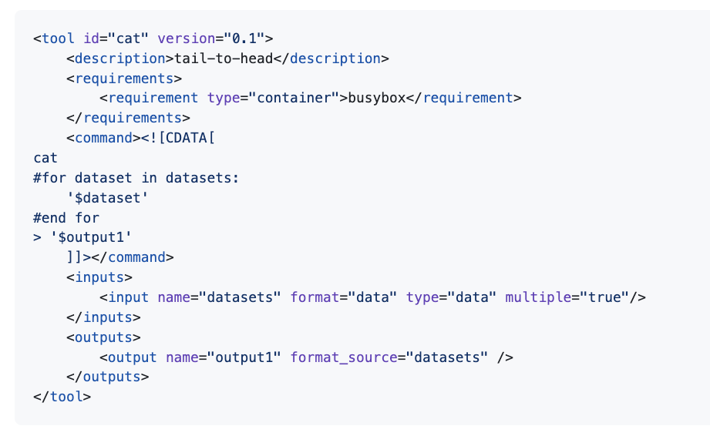
Templating with Cheetah

Slide 5
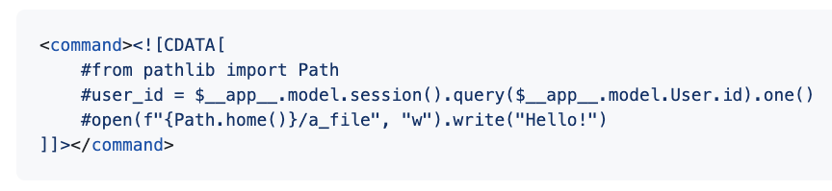
Templating with Cheetah 🎃

Slide 6
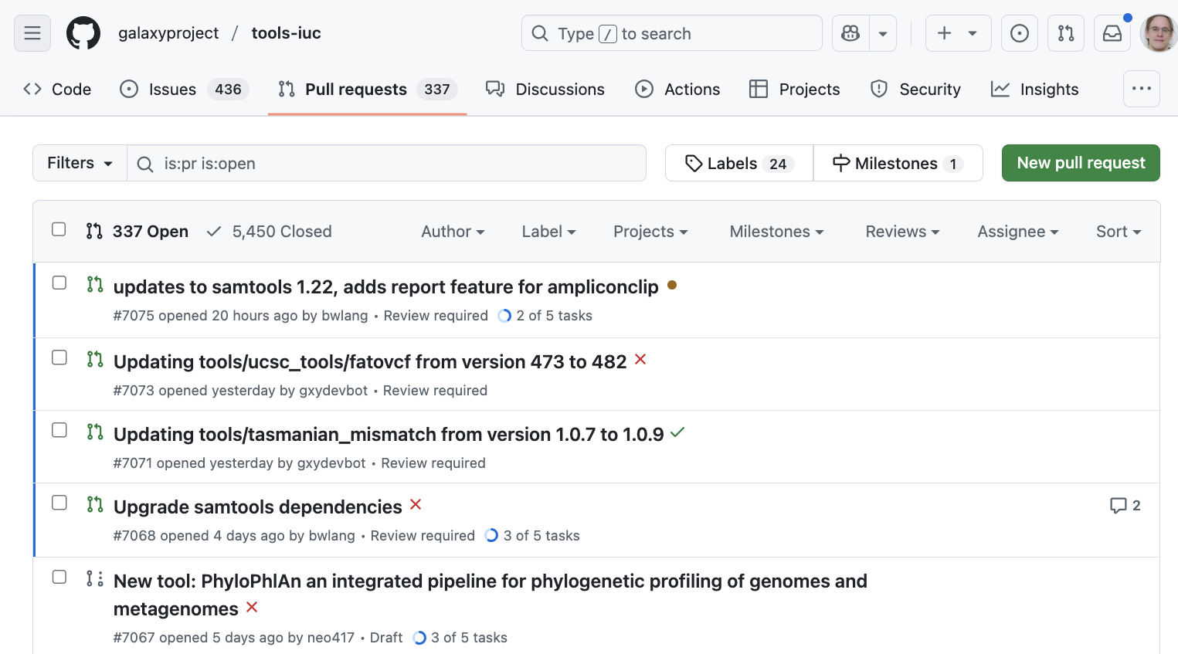
How do we manage 1000s of tools ?
Notes:
Galaxy (XML) tool language is very open
Requires review from experts to ensure cannot be exploited
Review and feedback process can be lengthy
Often it isn’t (immediately) clear what is a problem
Extensive documentation and XML schema, but still no formal guarantees of correctness

Slide 7
There has to be a better way!

Slide 8
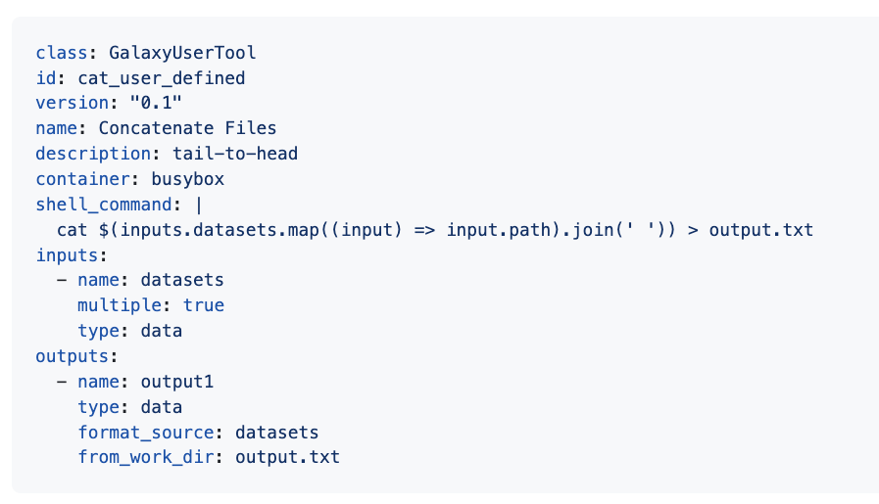
Javascript expressions & JSON inputs

Slide 9
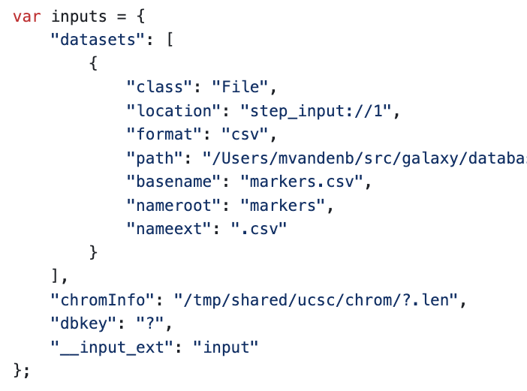
Javascript expressions & JSON inputs

Slide 10
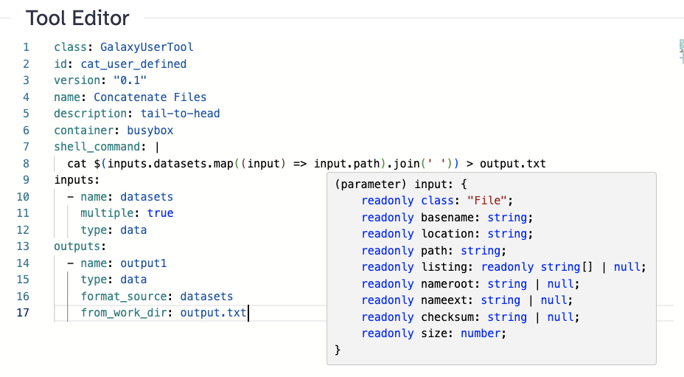
Javascript expressions & JSON inputs

Slide 11
Javascript expressions & JSON inputs

Slide 12
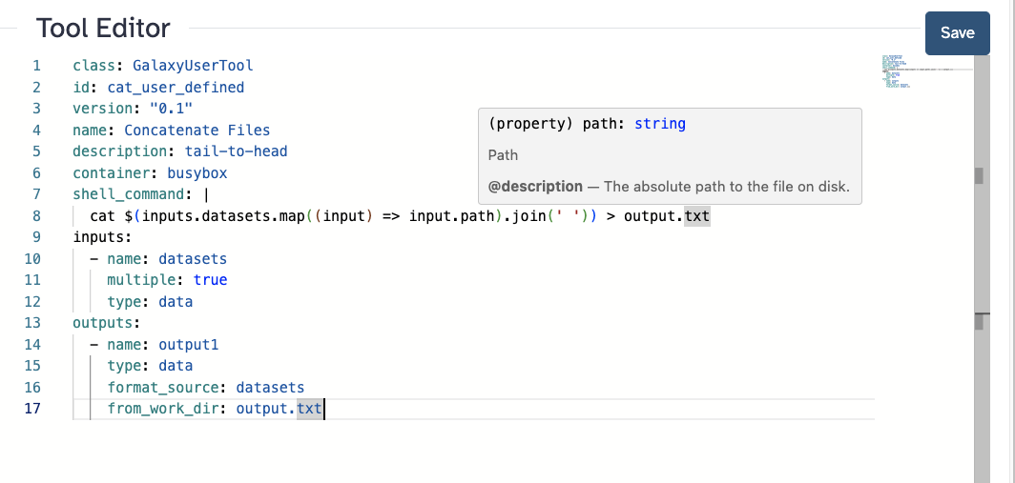
Monaco + YAML schemas

Slide 13
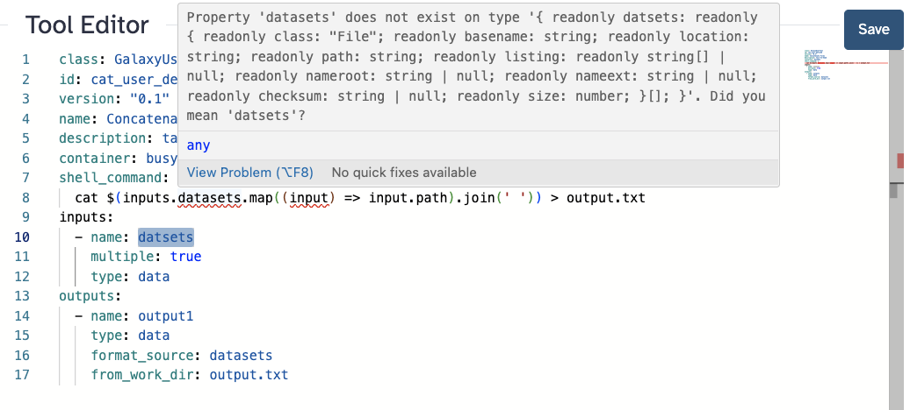
Monaco + Typescript interfaces

Slide 14
Behind the scenes
Tool parameters are modeled as Pydantic models
As a general schema that describes “A Galaxy Tool”
As a specialized schema for “This Galaxy Tools’ Potential Input Object”
Pydantic models are transform to JSON schema
JSON schema is transformed to typescript interface for runtime inputs
Monaco Editor renders tool source
Knows what to do with yaml schema for tool
Understands typescript interface and compares to code in javascript fragments

Slide 15
Behind the scenes

Slide 16
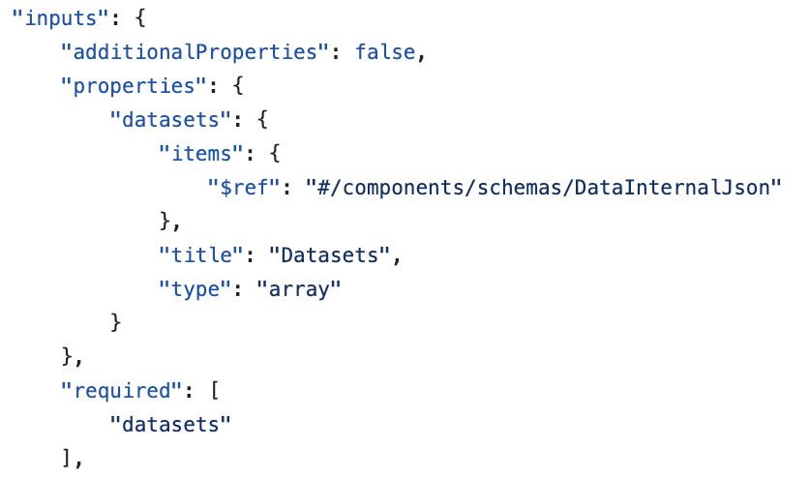

Slide 18
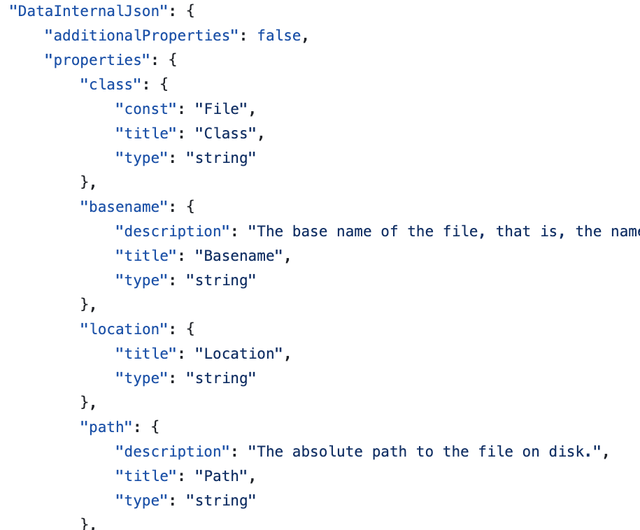

Slide 19
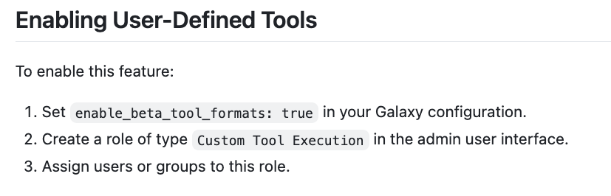

Slide 20
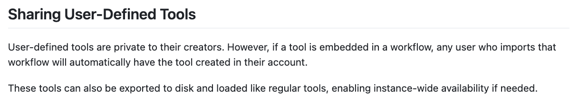

Slide 22
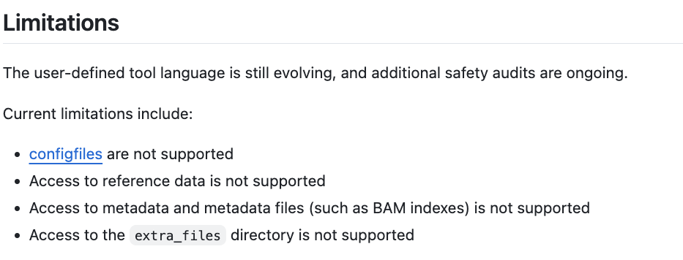

Slide 23
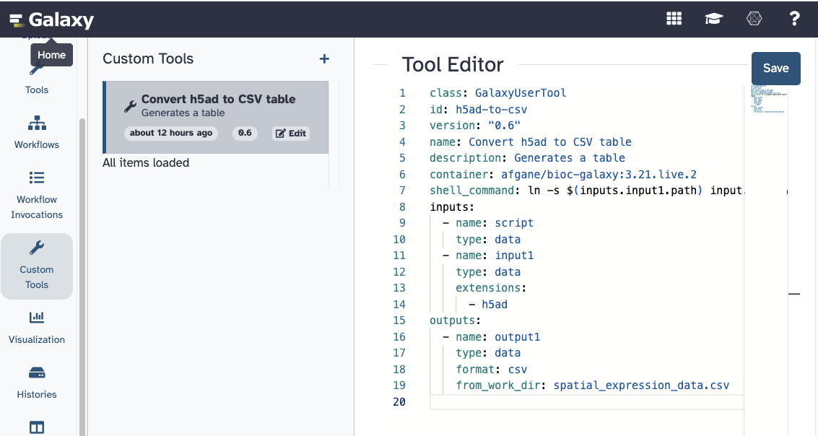
Coming to a server near you soon!
Special Thanks to
John Chilton
Michael Crusoe
Nicola Soranzo

